Slide 1

HISTORY OF WINDOWS THROUGH WINDOWS 10
-1806 Aishani
-1855 Dhruvi
ENTER

Slide 2


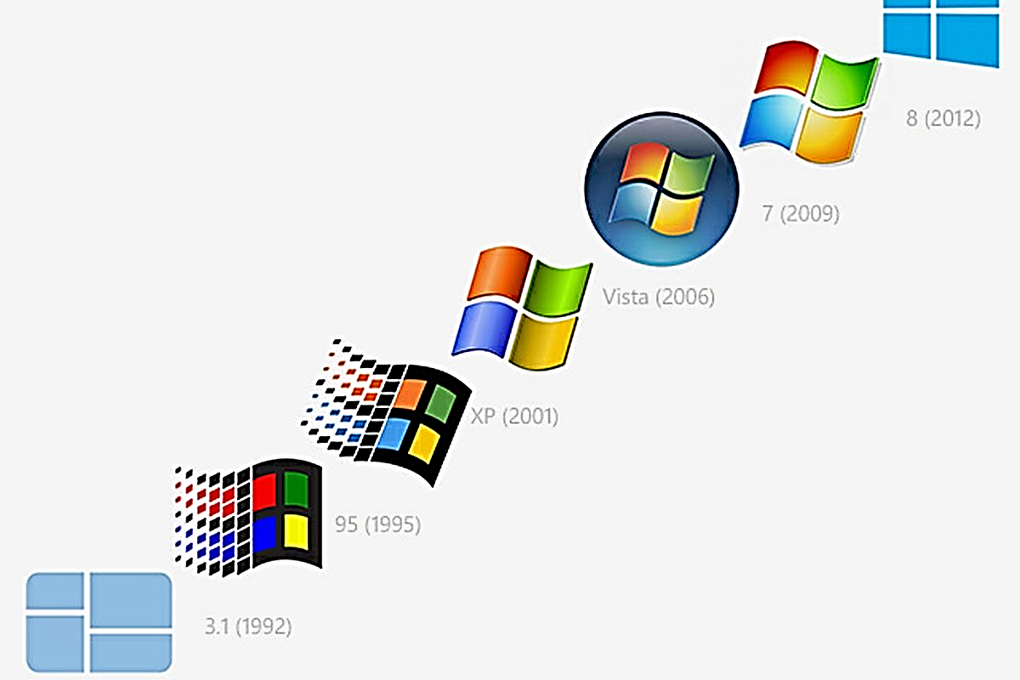

Microsoft Windows, commonly referred to as Windows, is a group of several proprietary graphical operating system families, all of which are developed and marketed by Microsoft. Active Microsoft Windows families include Windows NT and Windows IoT Windows 10, The most recent version for server computers is Windows Server, version 20H2. A specialized version of Windows also runs on the Xbox One video game console.
A QUICK INTRODUCTION ABOUT WINDOWS
01
02
03
04

Slide 3
CONTD…
Microsoft Windows came to dominate the world's personal computer (PC) market with over 90% market share, overtaking Mac OS, which had been introduced in 1984. Microsoft, the developer of Windows, has registered several trademarks, each of which denotes a family of Windows operating systems that target a specific sector of the computing industry.
01
Windows NT
Windows 9x
Windows Mobile
Windows IoT
02
03
04

Slide 4
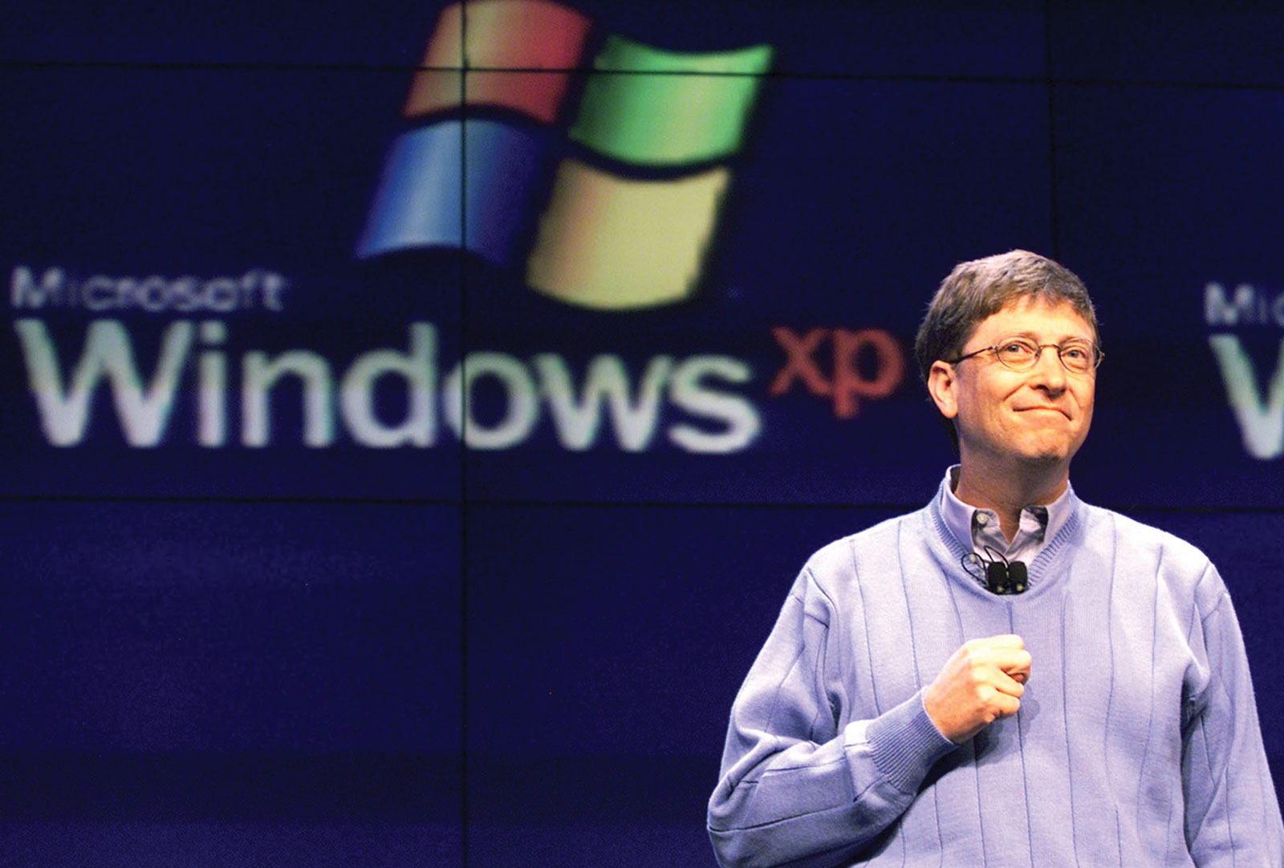
HISTORY OF WINDOWS
Microsoft Windows was announced by Bill Gates on November 10, 1983
Microsoft introduced Windows as a graphical user interface for MS-DOS, which had been introduced two years earlier.
01
02
03
The first versions of Windows were graphical shells that ran from MS-DOS.
04
Microsoft’s development of the Windows operating system for PC-based computers
as well as servers can be divided into four eras: MS−DOS, MS−DOS-based
Windows, NT-based Windows, and Modern Windows.

Slide 5
WINDOWS 10
Windows 10 is a series of operating systems developed by Microsoft and released as part of its Windows NT family of operating systems.
Release:
On September 30, 2014, Microsoft announced Windows 10 as the successor to Windows 8.1.
It was released on July 29, 2015, and addresses shortcomings in the user interface first introduced with Windows 8.
Announcement:
Microsoft has announced that Windows 10 will be the last major version of its series of operating systems to be released. Myerson said that Windows 10 would be Microsoft's "most comprehensive platform ever"
01
02
03
04

Slide 6
USER INTERFACE AND DESKTOP ON WINDOWS 10
A new iteration of the Start menu is used on the Windows 10 desktop, with a list of places and other options on the left side, and tiles representing applications on the right.
The menu can be resized, and expanded into a full-screen display, which is the default option in Tablet mode.
Universal apps, which previously could be used only in full screen mode, can now be used in self-contained windows similarly to other programs.
Windows 10 is designed to adapt its user interface based on the type of device being used and available input methods.
01
02
03
04

Slide 7
FEATURES OF WINDOWS 10
Windows 10 supports universal apps, an expansion of the Metro-style first introduced in Windows 8.
The Windows user interface was revised to handle transitions between a mouse-oriented interface and a touchscreen-optimized interface based on available input devices
01
02
03
04
Windows apps share code across platforms, have responsive designs that adapt to the needs of the device and available inputs, can synchronize data between Windows 10 devices
Windows 10 also introduced the Microsoft Edge web browser, a virtual desktop system, a window and desktop management feature called Task View

Slide 8
A TIMELINE-WINDOWS VERSION HISTORY
WINDOWS HOME SERVER 2011
01
WINDOWS ME
WINDOWS 1.0
WINDOWS 98
WINDOWS VISTA
WINDOWS 95
WINDOWS 10
WINDOWS 3.0
02
1987
1992
1996
Feb 2000
2001
2009
2012
03
2014
1985
1990
1998
2006
2011
1995
Sept 2000
04
WINDOWS 8
WINDOWS 3.1X
WINDOWS XP
WINDOWS 7
WINDOWS 2.0
WINDOWS NT 4.0
WINDOWS 2000

Slide 9
THANKS!
01
02
03
04

